Slide 1

MODULE 5

Slide 2
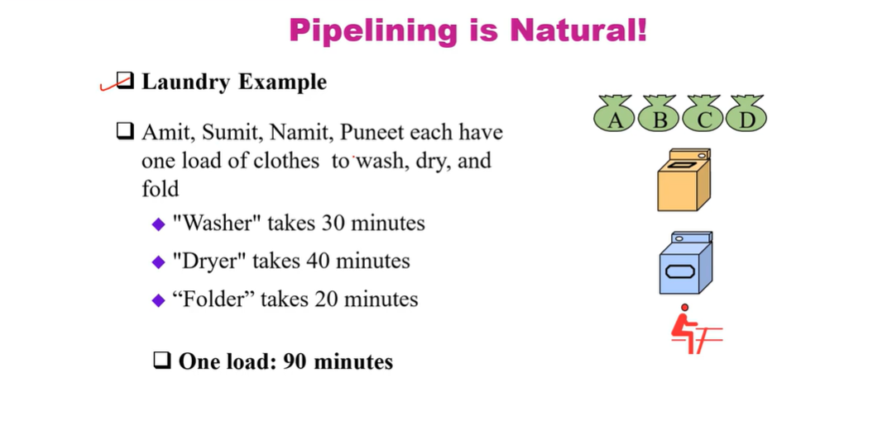
INTRODUCTION TO PIPELINING

Slide 3
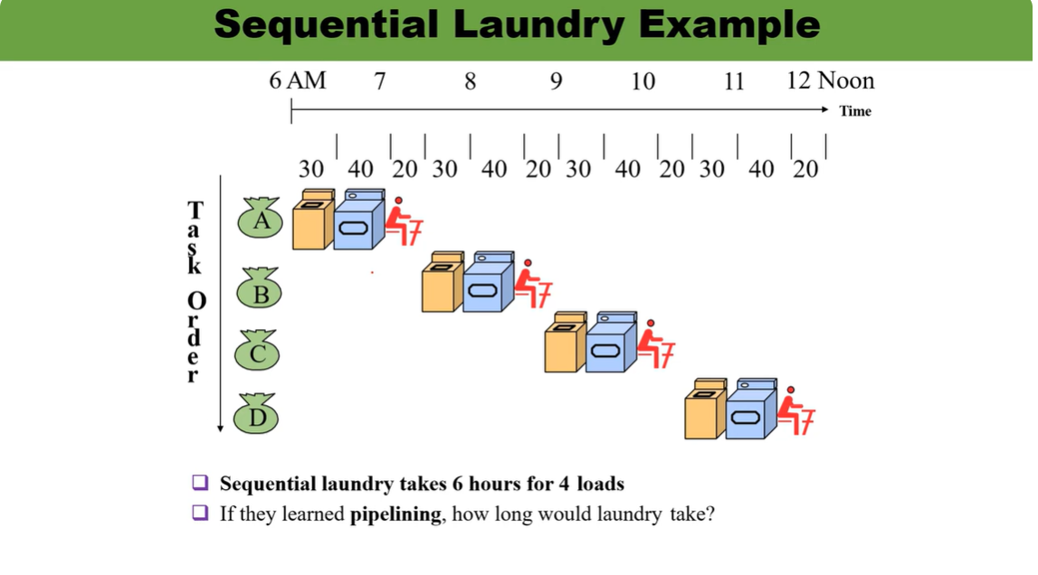

Slide 4
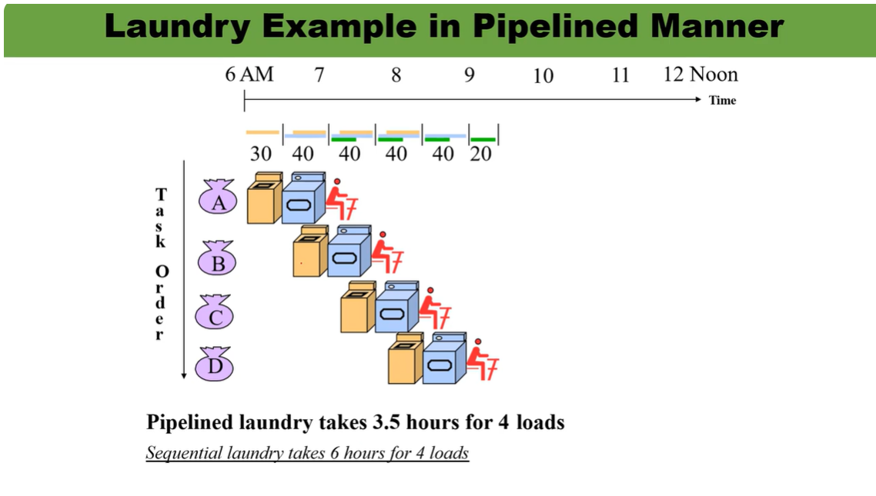

Slide 5
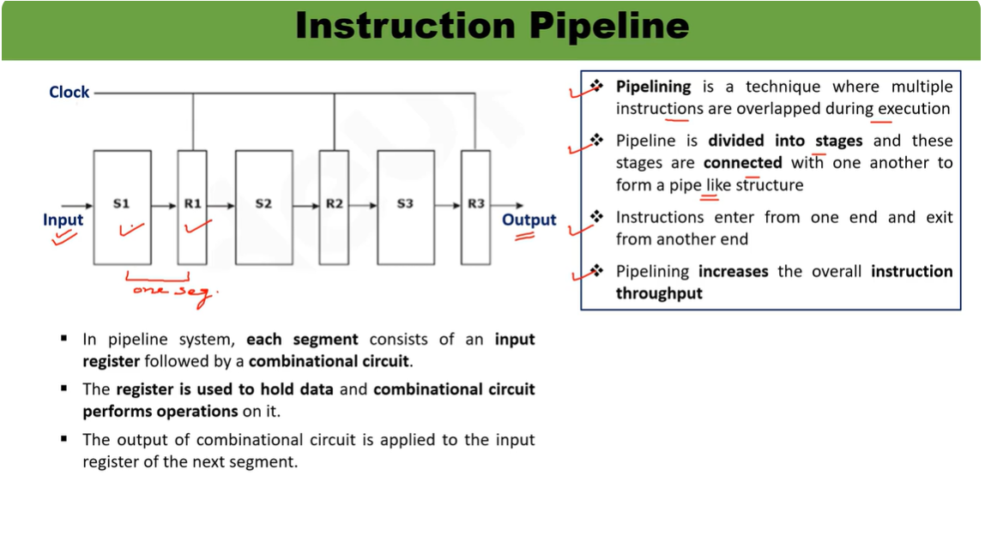

Slide 6
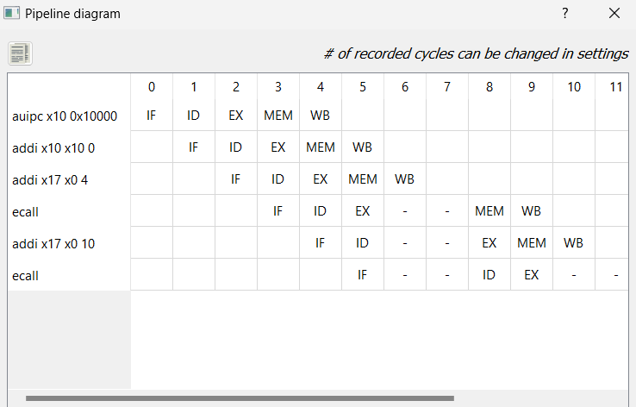

Slide 7
TOTAL NUMBER OF CLOCK CYCLE Speed =NP/p = 40cc/12cc =3
If N Instruction efficiency/utilization=total no of block/utilized block
I st instruction complete= 1* Number of pipeline Stages =60/40 =3/2
=1*k(k= no of of pipeline stages)
N-1 instruction take 1 clock cycle
Total= k+(n-1)
Eg: 5 stages 8 instruction k=5; n=8
Total time= k+(N-1) = 5+(8-1) =12
CPU equivalent to 1

Slide 8
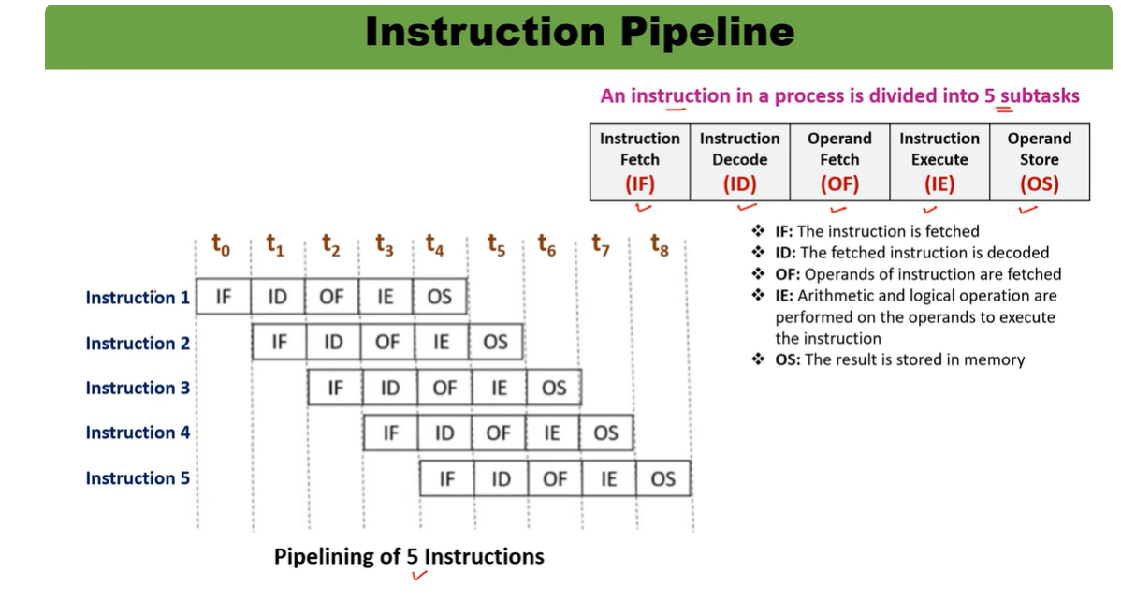

Slide 9
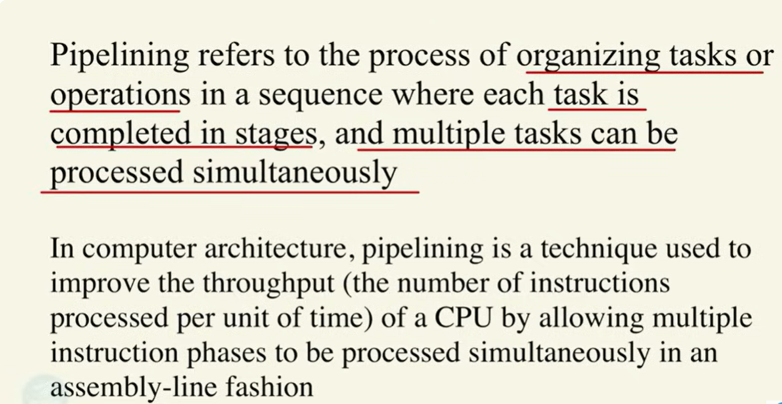
PIPELINING

Slide 10
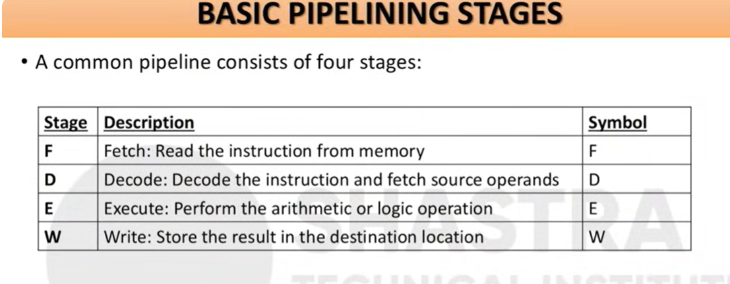

Slide 11
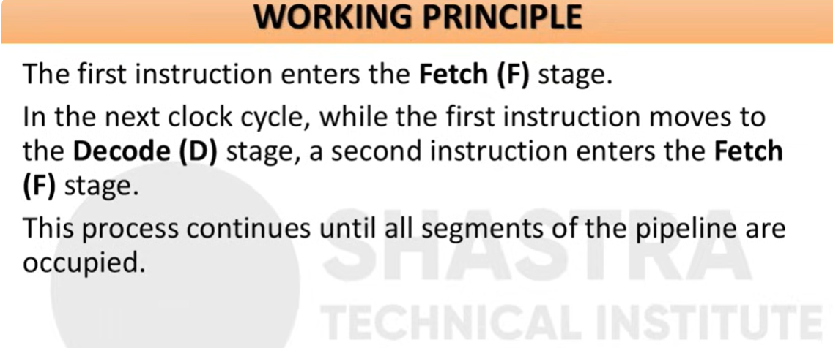

Slide 12
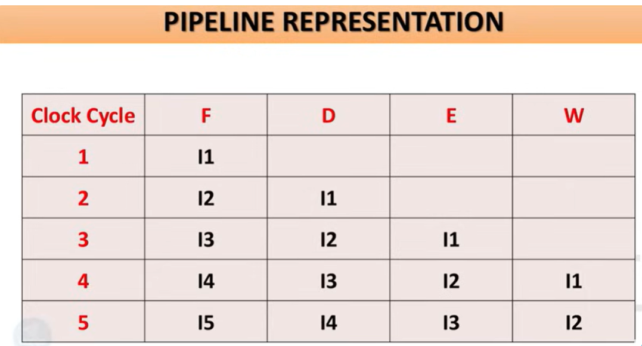

Slide 13
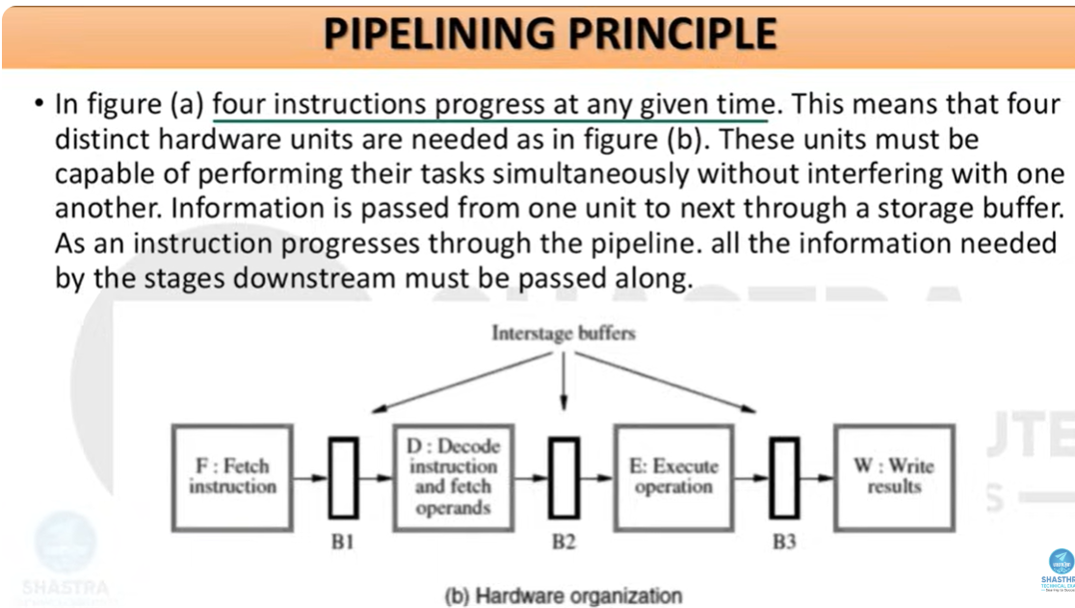

Slide 14
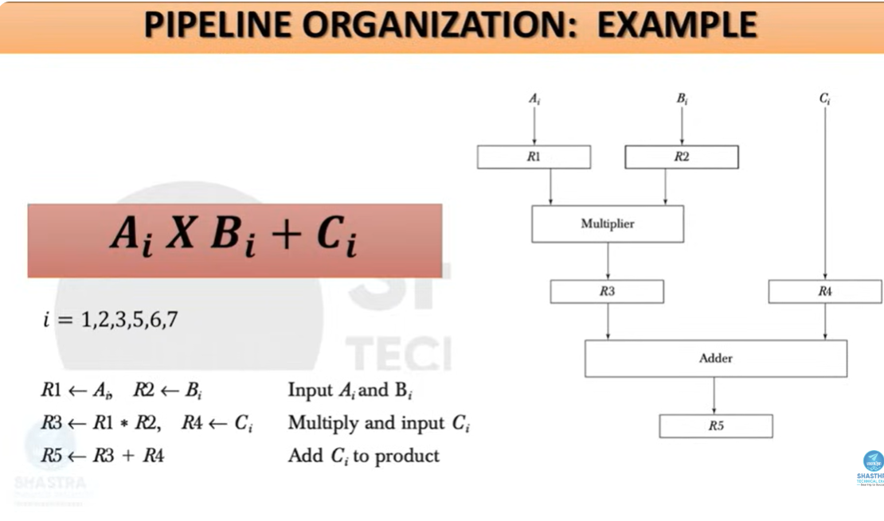

Slide 15
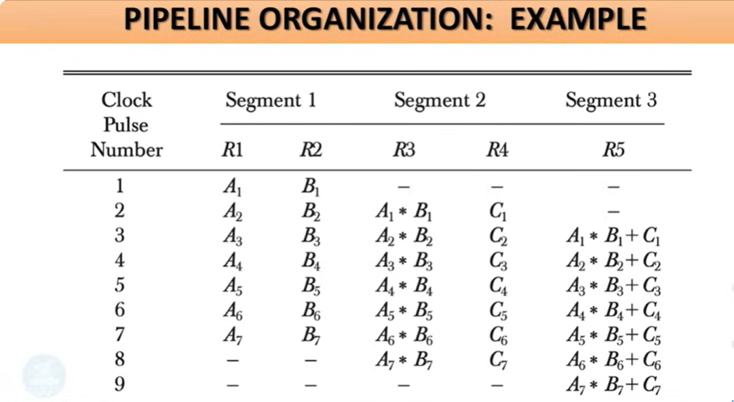

Slide 16
HAZARDS
To exploit ILP, we must determine which instructions can be executed in parallel.
If two instructions are parallel, they can be executed in pipeline without any stalls.
If two instructions are dependent on each other, they must be executed in order.
The situations in pipelining where the next instruction cannot execute in the following clock cycle are called hazards.
Three types: Structural, Data, and Control hazards.

Slide 17
Data Hazards
When a planned instruction cannot execute in the proper clock cycle because of the lack of availability of the required data.
The pipeline stalls because one step must wait for another to complete.
Data hazards arise because of the dependence of one instruction on an earlier instruction that is still in the pipeline.
Three types of data hazards according to the order of read and write access in the instruction:
RAW, WAR, WAW.

Slide 18
RAW
Consider two instructions i and j, with i preceding j in the program order.
RAW(Read After Write): j tries to read a source before i writes it. So j incorrectly get the old value.
add x3, x5, x6
sub x5, x3, x4

Slide 19
WAR
WAR (Write After Read): j tries to write the source before i read it. So i incorrectly gets the new value.
add x1, x2,x3
sub x2, x4, x5
WAW(Write After Write): j tries to write an operand before it is written by i.
sub x3, x1, x2
add x3, x4, x5

Slide 20
HARDWARE-Forwarding
The data hazard problem can be eliminated using a simple hardware technique called forwarding or bypassing or short-sircuiting.
Forwarding means passing a result directly to the functional unit that requires it.
Pipeline Registers: The registers which are introduced between the successive stages of the pipeline, so that at the end a clock cycle all the results from a stage are stored and can be used as input to the next stage in the next clock cycle

Slide 21
The results are forwarded from the pipeline register of a stage to the input of another.
Forwarding paths are valid only if the destination stage is later in time than the source stage.

Slide 22
However, forwarding cannot completely prevent stalls.
Suppose the first instruction was a load instead of an add. (Load-use data hazard)
Load-use data hazard means a specific type of data hazard in which the data being loaded by the load instruction has not yet become available when it is required by another instruction

Slide 23
CODE RECORDING
Code reordering is a technique used by compilers to rearrange the order of instructions without changing what the program does to make the program run faster.
When a CPU executes instructions, some take longer than others. If one instruction has to wait for data (for example, from memory or a previous calculation), the CPU can do something else in that waiting time. The compiler can move those other independent instructions earlier this is called reordering.
Code reordering = Changing the order of instructions to reduce idle time in the CPU, but keeping the same result

Slide 24
Simple Example (No Reordering vs. With Reordering)
Without code reordering:
LW R1, 0(R2) ; Load from memory (takes time)
ADD R3, R1, R4 ; Needs R1 (must wait)
SUB R5, R6, R7 ; Independent work
Here, the ADD must wait until LW finishes loading.

Slide 25
With code recording
LW R1, 0(R2) ; Load R1 from memory
SUB R5, R6, R7 ; Do independent work meanwhile
ADD R3, R1, R4 ; Now R1 is ready, no waiting
This reordering keeps the CPU busy instead of waiting — so it runs faster.

Slide 26
STRUCTURAL HAZARDS
Occurs when two or more instructions require the same hardware resource at the same time.(eg. Memory, ALU, registers etc.)
Detection involves identifying if two instructions are requesting the same resource in a given clock cycle.

Slide 27
CONTROL HAZARDS
Control hazards occur when the CPU cannot determine the next instruction to fetch because the outcome of a branch or jump is not yet known. Also called branch hazards.
Arises from branch instructions, conditional jumps, function calls/returns.
The Program Counter (PC) update depends on the branch decision, which is resolved late in the pipeline.

Slide 28
In a classic 5-stage pipeline (IF–ID–EX–MEM–WB),
branch outcome is usually known in EX stage.
This means 2 or more instructions after the branch might have been
fetched incorrectly.
IMPACT
Pipeline stalls: Fetching is paused until the branch outcome is known.
Pipeline flush: Wrongly fetched instructions are discarded, wasting cycles.
Reduces Instruction-Level Parallelism (ILP).

Slide 29
1. CMP R1, R2 ; Compare two values
2. BEQ LABEL1 ; If they are equal, jump to LABEL1
3. ADD R3, R4, R5; Instruction after branch
LABEL1: SUB R6, R7, R8
When the CPU reaches BEQ LABEL1, it doesn’t know immediately if it should execute line 3 or jump to LABEL1.
If it keeps fetching line 3 but the branch is taken, line 3 is a waste and must be thrown away.If it waits to see the result, it wastes time (stall).
This moment of uncertainty is what we call a control hazard.

Slide 30
CONTROL HAZARD MITIGATION- HARDWARE TECHNIQUE
1)Branch Prediction
Branch prediction is a technique where the processor guesses the outcome of a branch instruction (taken or not taken) before the actual condition is known. The main goal is to keep the instruction pipeline filled without waiting for the branch decision to be resolved.
There are two main types:
Static branch prediction uses fixed rules determined at design or compile time. For example, backward (loop) branches are predicted as taken, and forward branches as not taken. This type of prediction is simple but not very adaptive to runtime behavior.
Dynamic branch prediction employs hardware mechanisms such as a Branch History Table (BHT) or Branch Target Buffer (BTB) that record past branch outcomes and use them to predict future branch behavior. Adaptive or two-level predictors can achieve high accuracy by learning patterns from program execution

Slide 31
Speculative Execution
Speculative execution allows the processor to execute instructions along the predicted path before the branch outcome is confirmed. If the prediction turns out correct, results are committed, avoiding delays. If incorrect, the speculative results are discarded, and the pipeline is flushed and restarted from the correct branch target.
This technique requires hardware support such as reorder buffers and commit logic to maintain precise exceptions and ensure correct program order. Although costly in terms of complexity and power, it significantly improves performance when branch predictions are accurate

Slide 32
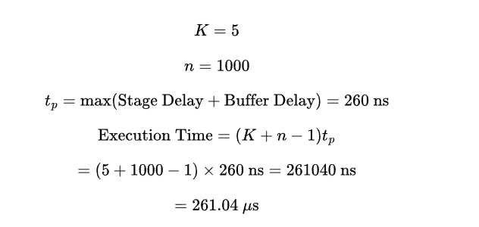
PROBLEMS
A 5-stage instruction pipeline has stage delays of 180, 250, 150, 170, and 250, respectively, in nanoseconds. The delay of an inter-stage latch is 10 nanoseconds. Assume that there are no pipeline stalls due to branches and other hazards. The time taken to process 1000 instructions in microseconds is __________ . (rounded off to two decimal places)

Slide 33
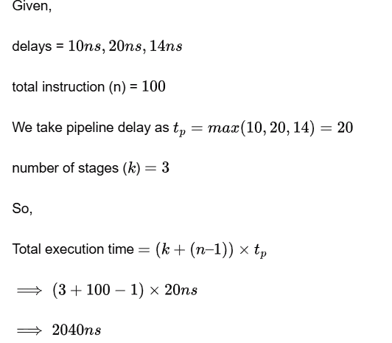
Consider a 3-stage pipelined processor having a delay of 10 ns (nanoseconds), 20 ns, and 14 ns, for the first, second, and the third stages, respectively. Assume that there is no other delay and the processor does not suffer from any pipeline hazards. Also assume that one instruction is fetched every cycle. The total execution time for executing 100 instructions on this processor is _______ ns

Slide 34
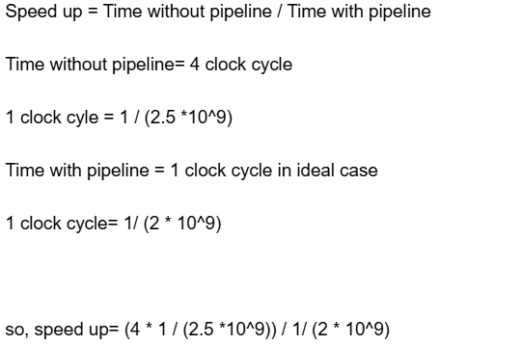
Consider a non-pipelined processor with a clock rate of 2.5 gigahertz and average cycles per instruction of four. The same processor is upgraded to a pipelined processor with five stages; but due to the internal pipeline delay, the clock speed is reduced to 2 gigahertz. Assume that there are no stalls in the pipeline. The speedup achieved in this pipelined processor is

Slide 35
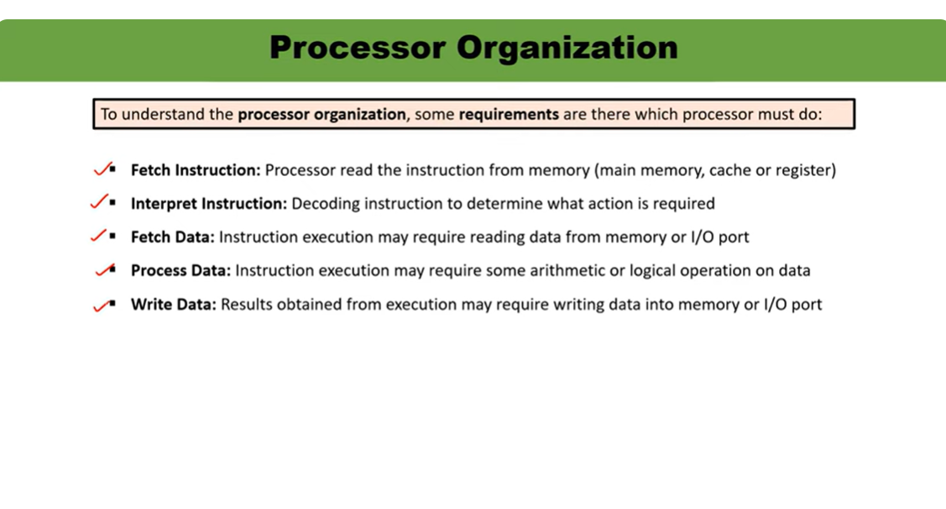

Slide 36
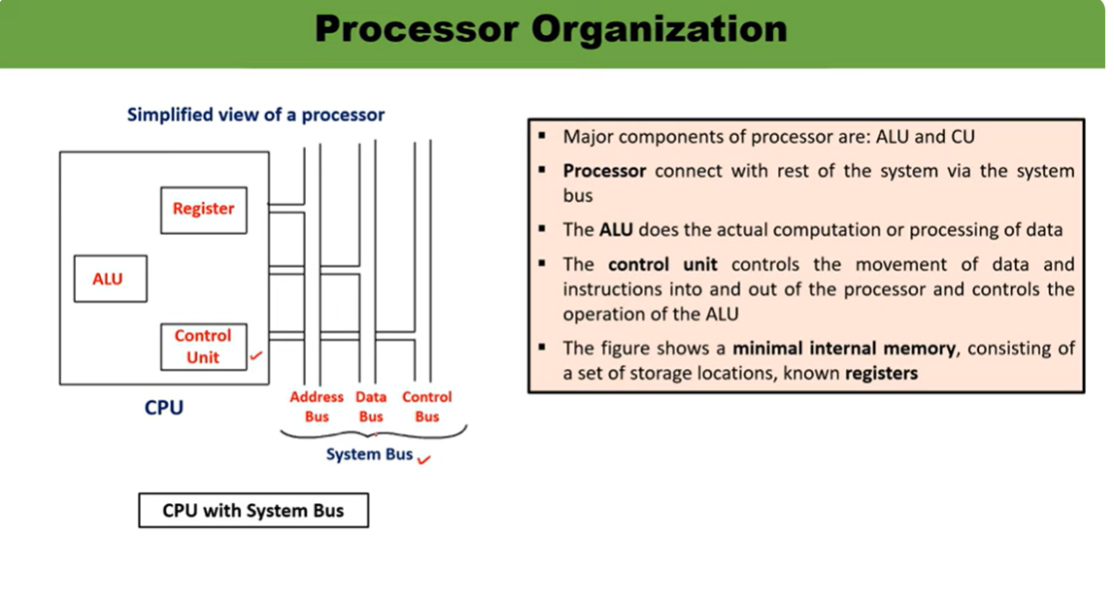

Slide 37
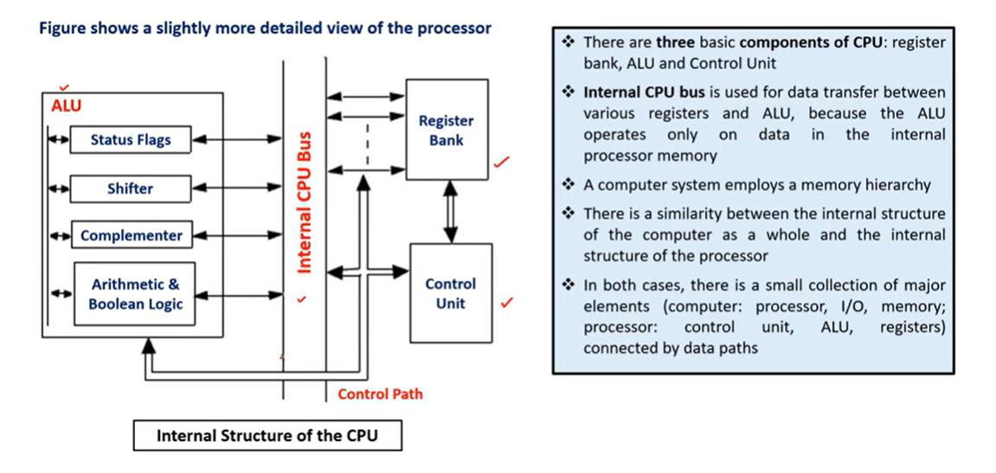

Slide 38
TYPES OF CPU ORGANIZATION
SINGLE ACCUMILATOR ORGANIZATION
GENERAL PURPOSE ORGANIZATION
STACK ORGANIZATION

Slide 39
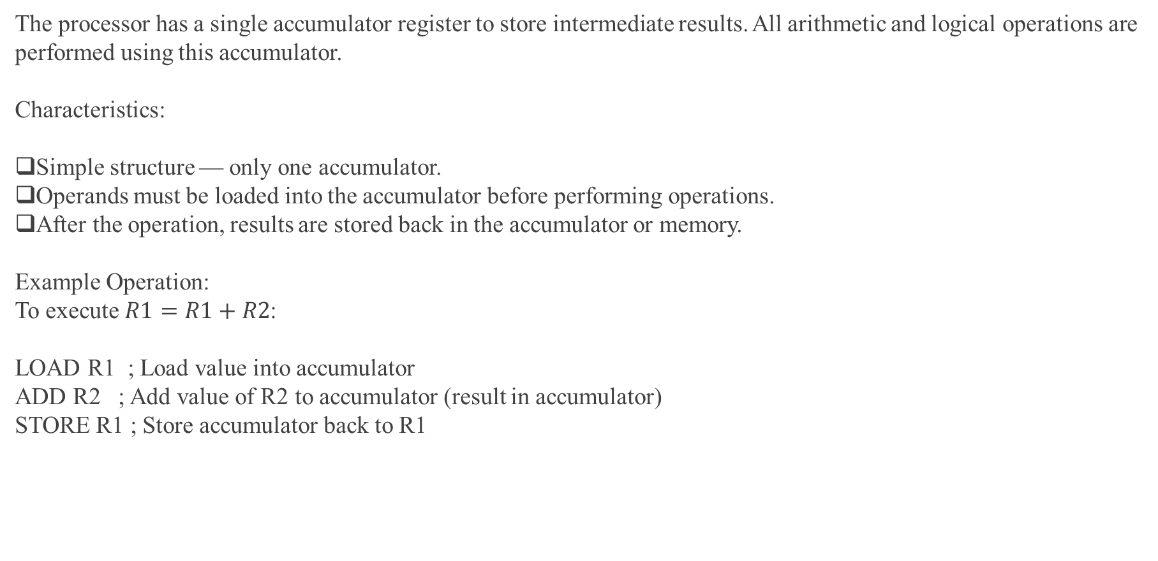
Single Accumulator
The processor has a single accumulator register to store intermediate results. All arithmetic and logical operations are performed using this accumulator.
Characteristics:
Simple structure — only one accumulator.
Operands must be loaded into the accumulator before performing operations.
After the operation, results are stored back in the accumulator or memory.
Example Operation: To execute $R1=R1+R2$:
LOAD R1 ; Load value into accumulator
ADD R2 ; Add value of R2 to accumulator (result in accumulator)
STORE R1 ; Store accumulator back to R1

Slide 40
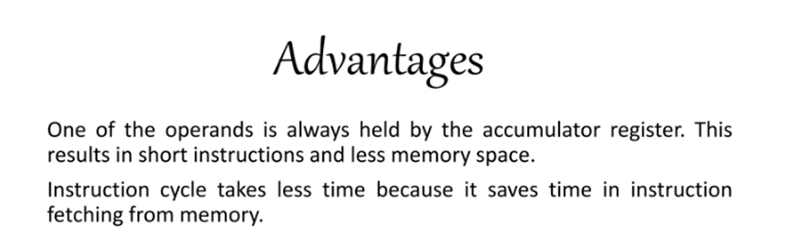
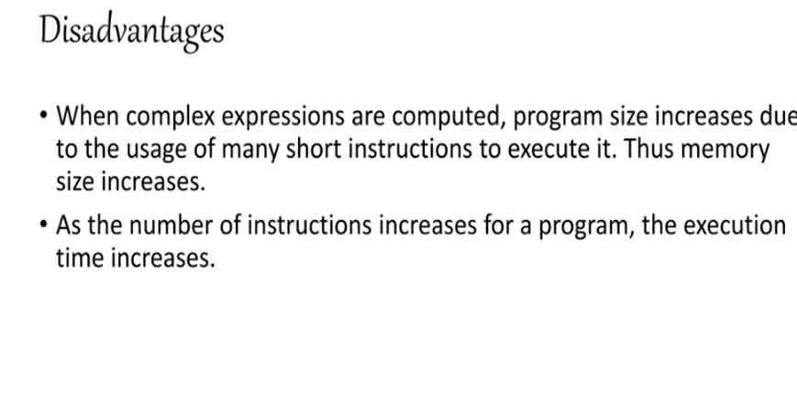

Slide 41
Control Unit
Accumulator
ALU
Memory

Slide 42
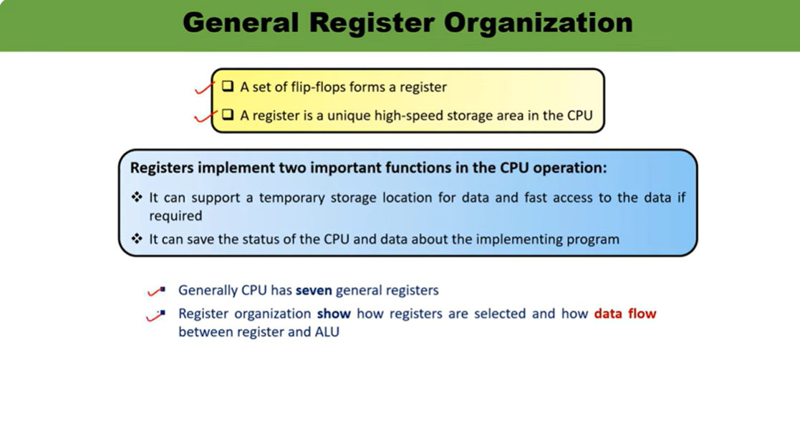

Slide 43

Multiple general-purpose registers are available; the CPU can use any for data storage or computation
.
Data flows through buses and multiplexers (MUX) to the ALU, and results can be stored in any register.
Control signals select which registers are sources and destinations for operations.
r1
rn
Mux(A/B)
ALU
Out put bus
Register Load

Slide 44
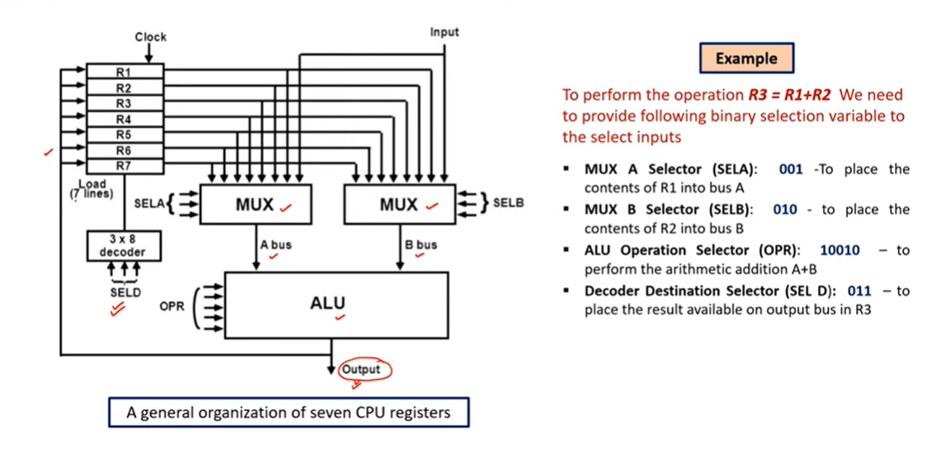

Slide 45
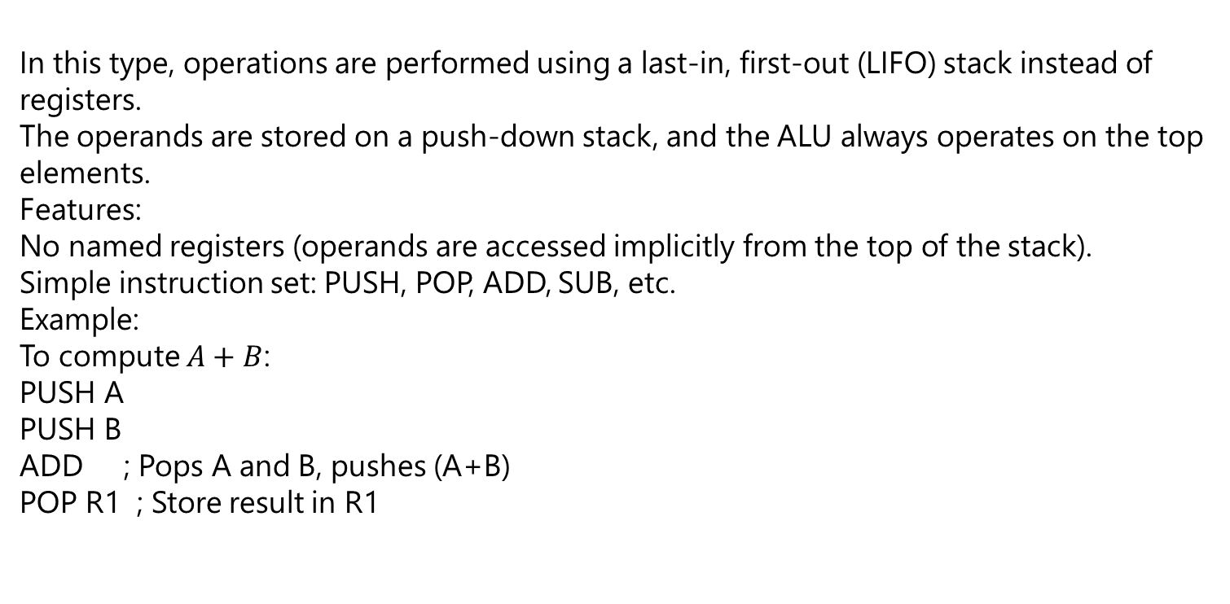
STACK ORGANIZATION
In this type, operations are performed using a last-in, first-out (LIFO) stack instead of registers.
The operands are stored on a push-down stack, and the ALU always operates on the top elements.
Features:
No named registers (operands are accessed implicitly from the top of the stack).
Simple instruction set: PUSH, POP, ADD, SUB, etc.
Example: To compute $A+B$:
PUSH A
PUSH B
ADD ; Pops A and B, pushes (A+B)
POP R1 ; Store result in R1

Slide 46
Advantages: Efficient for some programming languages (like those using recursion); simplifies code generation for function calls and returns.
Disadvantages: Limited direct access to data, making some operations slower.
TOP
Operated by ALU
Stack

Slide 47
Type | Data Storage | Main Advantage | Main Drawback
Single Accumulator | One accumulator register | Simple & low hardware cost | Many memory accesses
General Register | Multiple registers | Fast, flexible, supports parallelism | More control logic needed
Stack | Stack memory (LIFO) | Compact instructions, no register addressing | Slower for complex operations

Slide 48
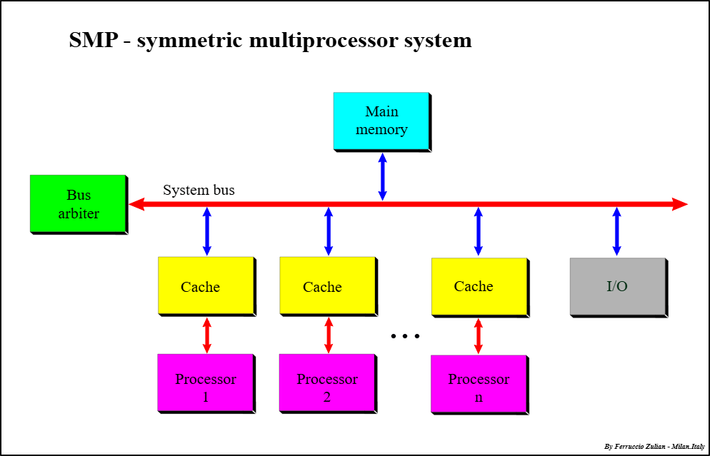

Slide 49
SMP
SMP is a computer architecture where two or more identical processors share a single main memory and I/O system.
All processors are peers — none are special or master. They share equal access to memory and peripherals.
Each processor can execute different tasks or threads independently but all run under a single operating system instance.
Key Characteristics of SMP
Uniform Memory Access (UMA): Every processor accesses all memory locations equally fast.
Processor Equality: No processor has priority; all can run processes.
Dynamic Load Balancing: The OS distributes workloads across processors for optimal performance.
Single OS Copy: One OS manages all processors.
Concurrency Control: The system manages simultaneous memory and I/O accesses to prevent conflicts.

Slide 50
How SMP Works
Multiple processors connected via a shared bus or interconnect.
They share the same physical memory and I/O channels.
Each processor has its own cache to speed up data access.
OS schedules tasks/threads dynamically on any free processor.
Advantages of SMP
Increased throughput: More processes can run at once since multiple processors work in parallel.
Reliability: If one processor fails, others continue running, so the system degrades gracefully.
Flexibility: The system handles many users or processes efficiently.

Slide 51
Disadvantages of SMP
Complex OS design: Managing multiple processors evenly requires sophisticated OS algorithms.
Memory bottleneck: All processors share one memory bus, which can become a performance limiter.
Cost: Larger shared memory and interconnects increase system cost.
Usually limited to around 16 processors due to these scaling challenges.
Typical Uses
Servers and workstations requiring multitasking and high reliability.
Systems running time-sharing, parallel processing, and multithreaded applications.

Slide 52
Two programming models used for multiprocessors are:
Shared Memory Model: In this model, multiple processors share a common address space and communicate by reading and writing to shared variables. Synchronization mechanisms like locks and semaphores are used to manage access. An example is the Uniform Memory Access (UMA) model, where all processors have equal access time to shared memory. OpenMP is a typical API used for programming in this model.
2.Message Passing Model: Each processor has its own local memory, and processors communicate by explicitly sending messages to each other. This avoids shared memory but requires more management of message passing. The Message Passing Interface (MPI) is a widely-used example of this model.

Slide 53
Vector SIMD (Single Instruction, Multiple Data)
processing is a parallel computing architecture where a single instruction operates simultaneously on multiple data elements organized in vectors.
Instead of executing one instruction per data item (scalar processing), SIMD performs the same operation on a whole vector of data in one go.
Example:
If you want to add two arrays:
A = [2, 4, 6, 8]
B = [1, 3, 5, 7]
A scalar processor adds one pair at a time, but a vector processor performs: A + B = [3, 7, 11, 15] in a single instruction cycle using vector registers.

Slide 54
Advantages:
High performance for scientific and multimedia applications.
Efficient use of memory bandwidth.
Simplifies programming for data-parallel tasks.
🔹 Examples of SIMD Architectures:
Cray vector processors (e.g., Cray-1)
Modern CPUs: Intel AVX, ARM NEON
GPUs: NVIDIA CUDA cores use SIMD-like execution

Slide 55
GPU -Graphics Processing Unit.
GPU stands for Graphics Processing Unit.
Graphics Processing Unit (GPU) is a specialized electronic circuit designed to rapidly process and manipulate data to produce images, animations, and videos for display.
Used for general-purpose parallel computing tasks, such as AI, deep learning, and scientific simulations.
It is a highly parallel processor originally designed for graphics and image processing.
Modern GPUs are now used for general-purpose parallel computing (GPGPU).
Each GPU has hundreds or thousands of small cores that execute the same instruction on different data — which is exactly the SIMD concept.

Slide 56
A GPU is a parallel processor that can execute thousands of small operations simultaneously, making it ideal for tasks that require the same operation to be performed on large sets of data.
Why GPU is Needed
A normal CPU (Central Processing Unit) can perform a variety of complex tasks — but only a few at a time. When it comes to graphics rendering, millions of pixels need to be processed together, which the CPU cannot handle efficiently.
Hence, GPU was developed to:
Handle large amounts of data in parallel.
Speed up image rendering and complex mathematical operations.
Reduce CPU workload for graphics and parallel tasks.

Slide 57
Working Principle (How GPU Works)
The CPU sends data (for example, image pixels or matrix values) and instructions to the GPU.
The GPU divides the work into many small parts.
Each GPU core performs the same instruction on different data at the same time.
All results are combined to form the final output (like a rendered image or computed matrix).
Example: Image Brightness Adjustment
Imagine an image has 1 million pixels. Each pixel’s brightness must be increased by 10.
CPU way: Increase one pixel’s brightness → move to next → repeat 1 million times.
GPU way: All 1 million pixels’ brightness values are increased simultaneously using thousands of GPU cores.

Slide 58
Applications of GPU
Graphics Rendering – Games, animations, 3D models Scientific Computation – Weather modeling, simulations Artificial Intelligence – Training neural networks Video Editing – Encoding and real-time rendering Medical Imaging – MRI, CT scan visualization Cryptocurrency Mining – Performs repetitive hash computations
Advantages of GPU
Massive parallel processing capability High throughput (many tasks per second) Great for repetitive operations on large data Reduces CPU load Ideal for AI, ML, and data-intensive tasks

Slide 59
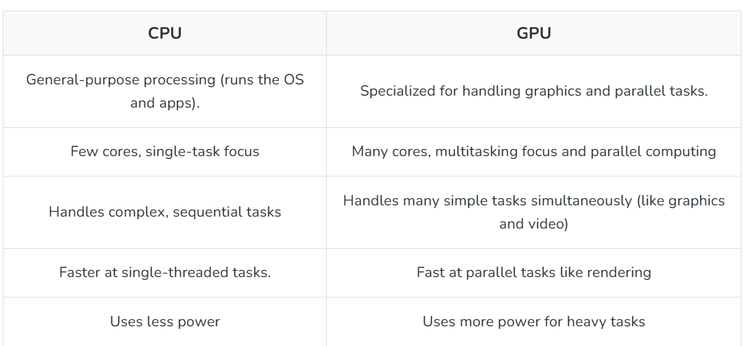

Slide 60
SHARED MEMORY MULTIPROCESSOR
A Shared-Memory Multiprocessor system is an architecture where multiple independent processors (or CPU cores) can all access a common memory address space.
processors can directly communicate and share data by simply reading from and writing to the shared memory locations using standard load and store operations.
This architecture follows the Multiple-Instruction, Multiple-Data (MIMD) paradigm, allowing different processors to execute different instruction streams on different data simultaneously.

Slide 61
Working Principle
All processors execute instructions concurrently and access shared data.
Synchronization mechanisms (locks, semaphores, barriers) ensure correct access to shared data.
Cache coherence protocols maintain consistency when multiple caches store the same memory block.

Slide 62
Key Characteristics and Components Shared Address Space
All processors see a single, unified view of the main memory.
Private Caches: Each processor usually has its own cache hierarchy (L1, L2, etc.) to improve performance by reducing memory access latency.
Interconnection Network: A mechanism like a bus, crossbar switch, or multi-stage network connects the processors and memory modules, facilitating data transfer.
Synchronization Primitives: Mechanisms like locks, semaphores, and barriers are necessary to coordinate access to shared data and resources, preventing race conditions and ensuring data integrity.
Cache Coherence: This is a critical challenge. Because each processor has a private cache, a data item modified in one processor's cache may not be up-to-date in other caches or in the main memory.
Cache coherence protocols (like Snooping or Directory-based protocols) are implemented in hardware to ensure that all processors see a consistent, up-to-date value for shared data

Slide 63
Models of Shared-Memory Multiprocessors
Type | Description | Example
UMA (Uniform Memory Access) | All processors have equal access time to shared memory. | Symmetric Multiprocessor (SMP)
NUMA (Non-Uniform Memory Access) | Memory access time depends on memory location relative to processor. | Modern high-performance servers
COMA (Cache-Only Memory Architecture) | Memory consists entirely of caches; data migrates dynamically. | Experimental systems

Slide 64
Advantages (Pros) | Disadvantages (Cons)
Simplified Programming Model: Developers use conventional programming constructs with a single, global address space, making parallel programming more intuitive. | Scalability Issues: As the number of processors increases, contention for the shared bus, memory bandwidth, and interconnect resources can become a major bottleneck, limiting performance gains.
Efficient Data Sharing: Communication is fast and efficient since processors can directly read/write shared data in memory, reducing communication overhead. | Cache Coherence Overhead: Maintaining data consistency across multiple caches (cache coherence) requires complex hardware protocols, which introduce significant overhead, especially as the system size grows.

Slide 65
CASHE COHERENCE
Cache Coherence is a fundamental problem in shared-memory multiprocessor systems (like UMA/SMPs and NUMA) where multiple processors maintain private caches.
The issue arises because a copy of the same shared data block can exist in several different private caches simultaneously, as well as in the main memory.
The system is considered cache coherent if, after a processor modifies a shared data item in its cache, all subsequent accesses to that item by any processor across the system return the modified value.

Slide 66
The Need for Coherence
A lack of coherence leads to a stale data problem, which can cause incorrect program execution
3Scenario:
Processor P1 reads variable X. It brings X into its private cache (Cache 1).
Processor P2 also reads variable X. It brings X into its private cache (Cache 2).
Processor P1 writes a new value, X to its copy of X in Cache 1.If P2 reads X again from Cache 2, it will read the old, stale value X, not the new value X.

Slide 67
To maintain coherence, a system must enforce two properties:
Write Propagation: Changes to the data in one cache must eventually be propagated to all other caches.
Write Serialization: Writes to the same location must be seen in the same order by all processors.

Slide 68
Cache Coherence Protocols
Hardware protocols are implemented to manage the state of shared data blocks and enforce coherence. They typically operate by tracking the state of each block in every cache. The two main types are:
Snooping Protocols:
All cache controllers "snoop" (monitor) the shared bus for memory transactions.
When a processor performs a write to a block it owns, it broadcasts this write operation onto the bus.Writes to Shared Data:
If a processor sees a write transaction for a block it also holds, it can either invalidate its local copy (marking it as stale) or update its local copy.

Slide 69
Best Suited for:
Bus-based Symmetric Multiprocessors (SMPs), where the number of processors is small to moderate (MESI Protocol):
A widely used snooping protocol that defines four states for each cache block:
Modified: The block is only in this cache and has been modified (dirty).
Exclusive: The block is only in this cache and is clean (matches main memory).
Shared: The block is in this cache and potentially in other caches; it is clean.Invalid: The block contains stale data.

Slide 70
2:Directory-Based Protocol:
Instead of broadcasting transactions to all processors, coherence information is centralized in a directory structure (often distributed across memory modules in a NUMA system).
The directory tracks which caches hold a copy of each memory block and the state of that block (e.g., shared, unmodified, owned).
When a processor wants to write to a block, it checks the directory.
The directory then sends explicit point-to-point messages (like invalidation requests) only to the specific caches that hold a copy.

Slide 71
Best Suited for: Large-scale multiprocessors with non-broadcast interconnection networks (like meshes or MINs), where broadcasting is inefficient or impossible.Scalability:
Much more scalable than snooping because the coherence traffic is limited to the nodes that actually share the data, reducing load on the network.

Slide 72
Parallel programming for multiprocessors
Parallel programming for multiprocessors is a method to divide computational tasks into parts that run simultaneously on multiple processors, improving performance and efficiency by leveraging the hardware parallelism.
Multiprocessors can be classified into tightly coupled systems (shared memory) where processors share a common memory, and loosely coupled systems (distributed memory) where each processor has its own memory and communicates through message passing.
Splitting: The initial task is broken down into smaller, independent subtasks.
Applying (Parallel Execution): These subtasks are distributed to and executed simultaneously by different processors or CPU cores.
Combining: Once each subtask is complete, the results are gathered and combined to produce the final outcome

Slide 73
Increased speed:
By performing multiple operations at the same time, the overall time to complete a task is significantly reduced.
Improved performance:
Parallel processing leads to a higher throughput and better utilization of system resources.
Scalability:
Performance can be increased further by adding more processors to the system

Slide 74
Applications
Parallel programming is used in many fields, including scientific computing, data science, and engineering, to handle large datasets and complex computations that are beyond the capabilities of a single processor.
Examples include simulations, data analysis, and complex modeling in fields like life sciences and aerospace.

